Slide 1
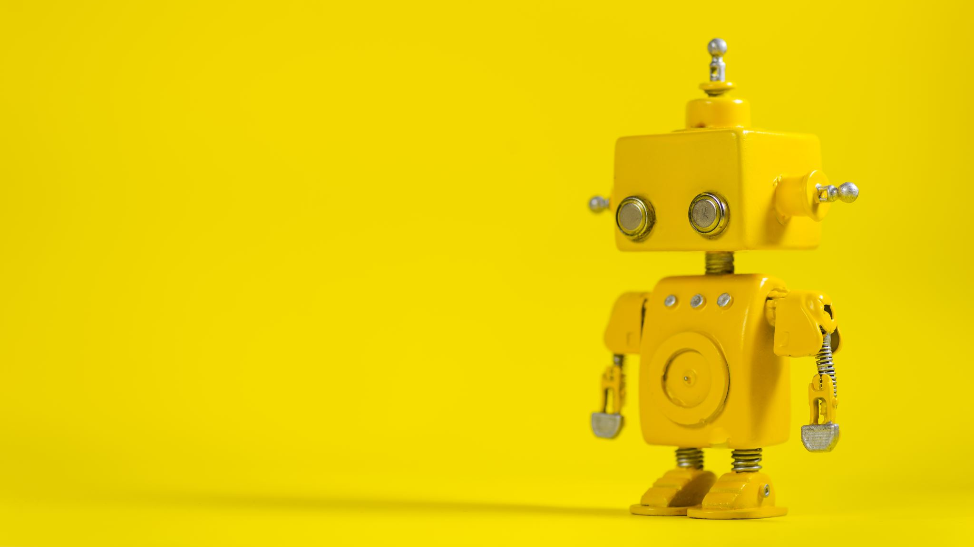
Building robots that help humans build better mental models of robots
Preeti Ramaraj
University of Michigan, Ann arbor
At the 41st soar workshop
Notes:
I work in the field of human robot interaction, and thus here I will be talking about mental models of robots -> specifically Interactive task learning robots

Slide 2
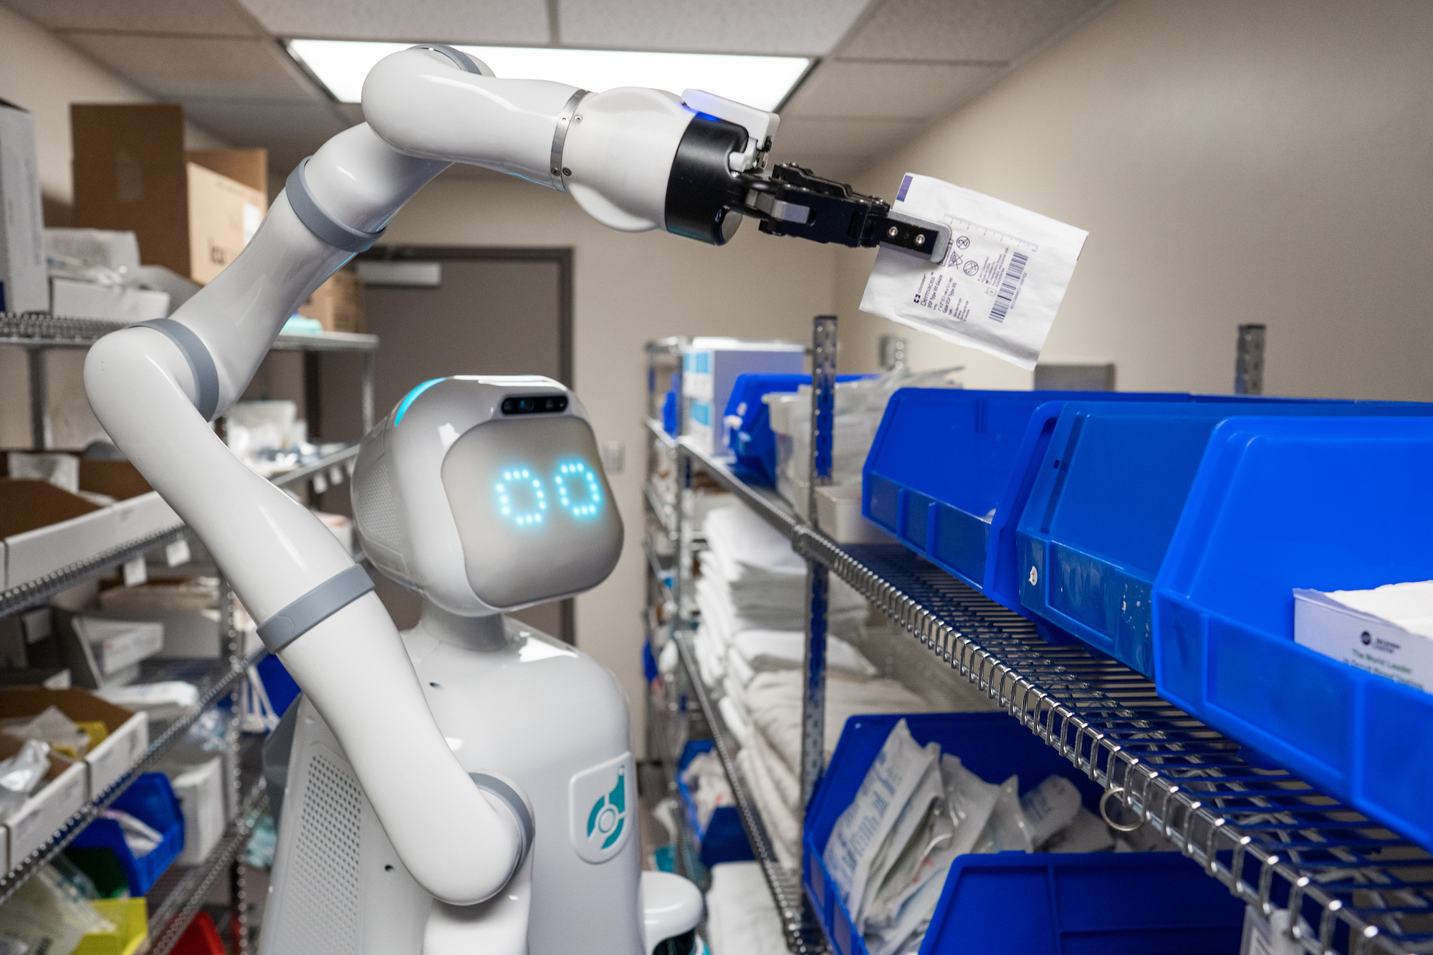
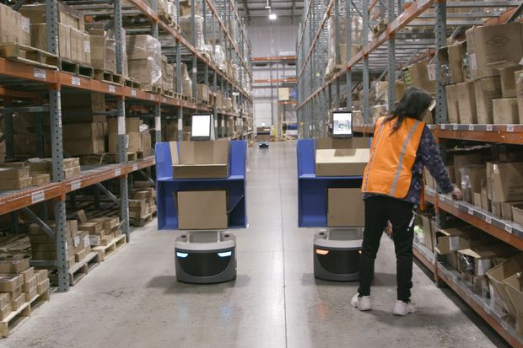
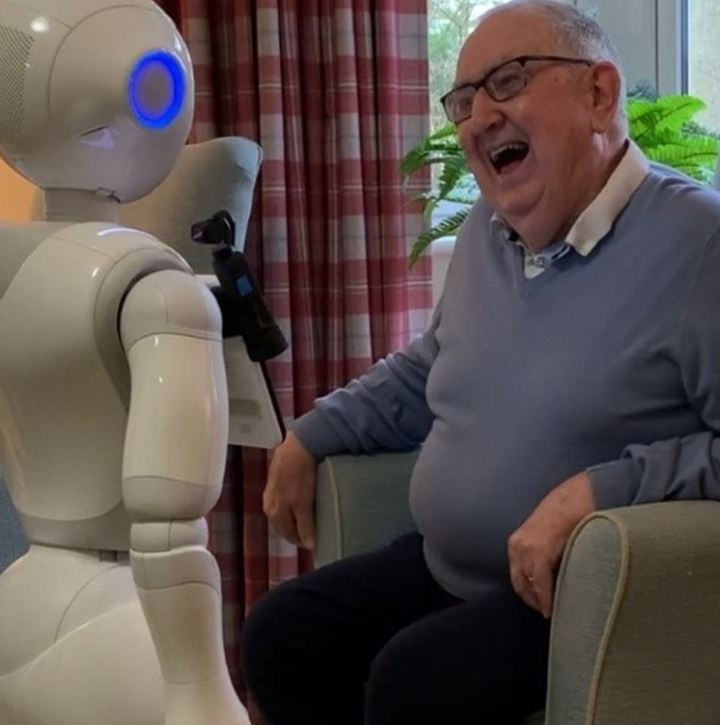
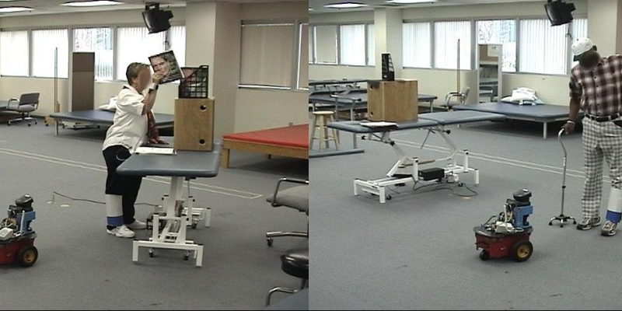
Hopeful future in robotics
https://www.wsj.com/articles/tis-the-season-for-surge-robots-as-holiday-hiring-finds-automation-11572255001
https://jneuroengrehab.biomedcentral.com/articles/10.1186/1743-0003-4-5
https://www.dailymail.co.uk/sciencetech/article-8707603/Robots-improve-mental-health-loneliness-older-people-study.html
https://diligentrobots.com/moxi
Notes:
I envision a future where robots help people by performing a diverse set of tasks. We want to enable everyday people to teach robots to do things they want it to do. well as environment setup to robots on the fy

Slide 3
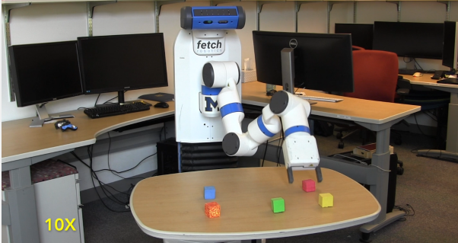
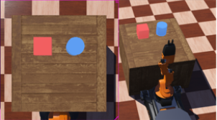
Interactive Task Learning (ITL)
Design of robots that acquire new knowledge through instructions from humans
High diversity of tasks
Interactively learn from non-experts
ROSIE
AILEEN
Notes:
There are two important reasons why this research approach is relevant
We cannot expect to preprogram all possible tasks a robot might be expected to do.
Second, it helps leverage people’s ability to teach interactively, something that they are used to. But is that a valid assumption?

Slide 4
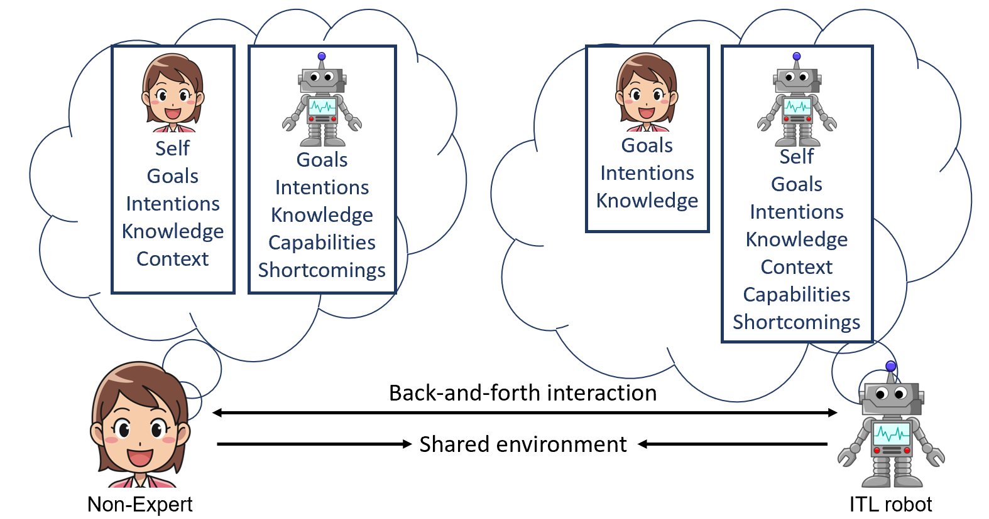
Human robot teaching interaction
Notes:
Video description: Teaching is inherently a back-and-forth interaction. And for this, in addition to having the model of their own self in terms of goal,int,knowledge, both the teacher and the robot would have assumptions about each other’s models as well which includes. These assumptions aren’t always correct, so thro interaction, they need to update it correctly.
In an hri interaction, the robot must engage in back-and-forth interaction with the teacher so that the teacher can teach it the requisite tasks.
To teach, the instructor must have a good model of the robot, because it is using this that they would define their instructions and blah
From a theory of mind perspective, in addition of having access to their own goals knowledge and beliefs, both the non-expert and the itl robot have assumptions about each other’s goals, intentions and knowledge that are relevant to the task. For a successful conversation, it is important that they can update these assumptions based on correct information. For my research, I care about this bit – i.e. the teacher’s mental model of the robot that consists of these things.
As opposed to a robot developer, a non-expert comes in with less experience and a myriad set of expectations that are very likely to vary from the actual robot’s model.
My focus is.
And for this, Both these aspects are relevant – in terms of what the human knows and needs to know and the robot knows and needs to know, and development is required in all these areas. it is important they coordinate and exchange relevant task information, information about themselves and their assumptions. But the “relevant” information is different when comparing a non-expert user to a robot developer. However, when it comes to a non-expert, given their lack of experience in comparison to a robot developer, they are likely to have an incomplete mental model consists of the non-expert’s knowledge of the robot’s capabilities, shortcomings etc.
Many different researchers are working on these different aspects to improve back and forth communication. There are many ways to measure the success of a conversation, but the part that I am interested in, is understanding the non-expert’s mental model of the robot. Why is that so? As opposed to a robot developer, a non-expert comes in with less experience and a myriad set of expectations that are very likely to vary from the actual robot’s model. And with incorrect expectations, the non-expert is likely to not know how to successfully interact with the robot. We only need see examples of virtual assistants and people grappling with them to see how big a role mental models play in these scenarios.
We as people engage in back and forth interaction, to correct each other’s assumptions keeping in mind the goal of the conversation. We are likely to adapt to the robot’s limited conversation (as we saw in the teaching video).

Slide 5
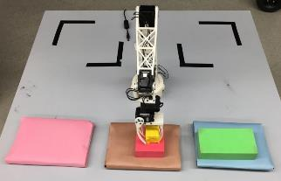
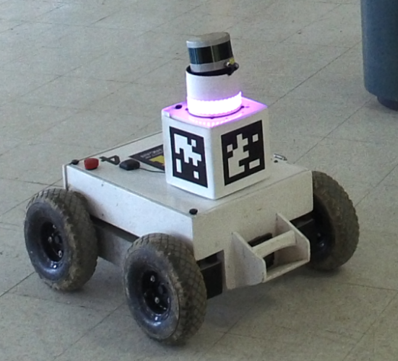
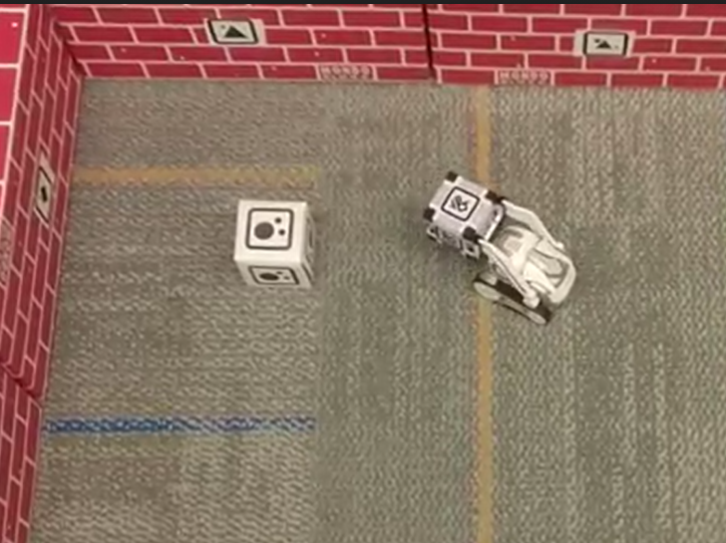
Interactive task learning robot - Rosie
Interactive Task Learning (ITL) agent built on Soar
Learns 60+ games and puzzles, and mobile delivery and navigation tasks
The teachers also happen to be the robot developers
Notes:
And true to the fact, in our own lab we have seen prior work from members in the lab such as Shiwali, James and Aaron has enabled Rosie to learn a complex set of tasks including games and puzzles and mobile delivery tasks, and enabled it to perform tasks in various embodiments as shown below.
But what’s missing?
For this we need to look at what a teaching interaction loks like.

Slide 6




Non-expert instructor has an incomplete mental model of the robot
?
…….
Instructor
ITL robot
Notes:
However, non-experts typically don’t have experience with robots, and come in with a myriad set of expectations, which means that they are likely to have an incomplete or even incorrect
So here, the instructor can ask what can the robot see, and based on its description, they are able to accurately update their mental model
Prior work has implemented tms to allow instructor access, but here we wanted to study it from the mental model perspective
So today my talk is going to be about how we implemented specific transparency mechanisms in order for a non-expert user to be able to identify why the robot failed. Clearly, this is the first crucial step.
How do we quantify this? By using the user’s accuracy and confidence to do the same.again, very little work has looked at just quantifying a person’s mental model when it comes to a robot. We think we ought to take a smaller step approach to this.

Slide 7
How can the robot help the instructor build a better mental model of itself?
Notes:
The robot needs to have a model of the human as well as the model of the human’s model of itself.
For the latter, we conducted a study

Slide 8
Outline
Working Example
What should the instructor know?
When and how do you update the instructor’s mental model?
Robot’s mental model of the instructor
Proposed implementation

Slide 9
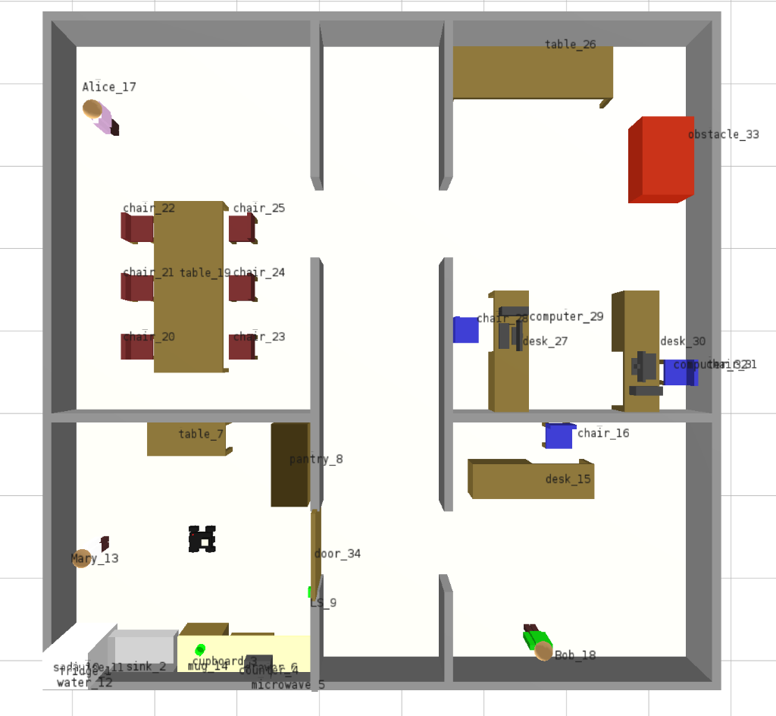
Working Example
Mary wants the robot to deliver the mug of
coffee to Alice who is in the conference room.
Look for the mug
Pick up the mug
Open the door to leave the pantry
Go to the conference room…
…….
Alice
Mary
Rosie
Mug
Notes:
Add labels

Slide 10
What should Mary know?
Robot knowledge
Perception
World representation
Declarative knowledge
Procedural knowledge
Interaction with the robot
Modes of interaction (questions, commands)
Robot’s interaction capabilities (confirmation,
ask for help, learn new concepts etc)
Alice
Mary
Rosie
Mug
Notes:
Even though to teach this task, Mary could really use all this information, it is impossible for us to assume that Mary can actually remember all this information all the time.
And this is where the modes of interaction show up. i.e. Mary can actually “interact” with the robot to learn these different types of knowledge about the robot. Now this can be achieved in two ways.
For today, I’m going to focus on the first half of this i.e. how should mary and the robot reach common ground on what the robot

Slide 11

Ask robot for information
Transparency mechanisms provide the instructor with information about robot’s knowledge
Transparency mechanisms
Instructor
ITL robot
Notes:
Actually talk about what you did. Say you tried TMs, maybe show a quick graph that it works (say that you test their mental model by asking them to predict knowledge)
How do we recover from such failures? One way to do it is using transparency mechanisms that an instructor can use to request information from the robot about it sknowledge.

Slide 12
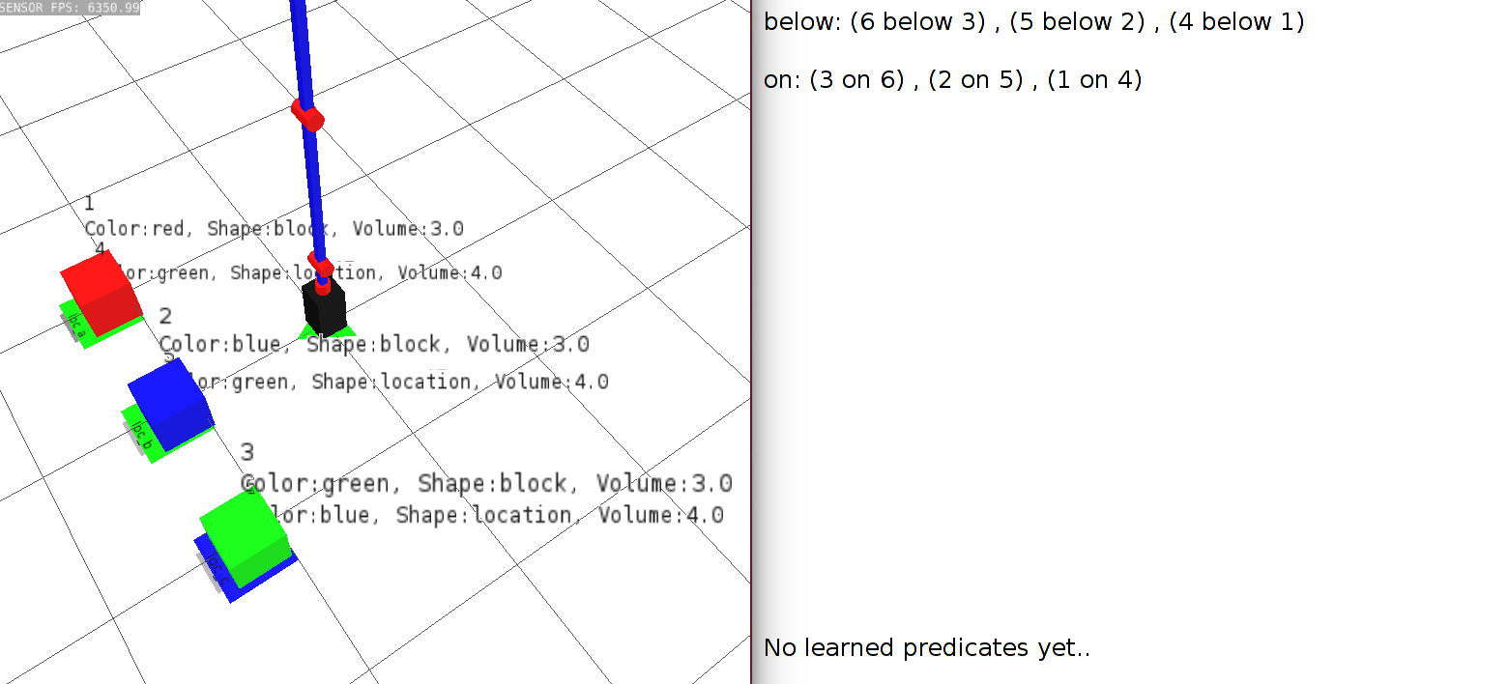
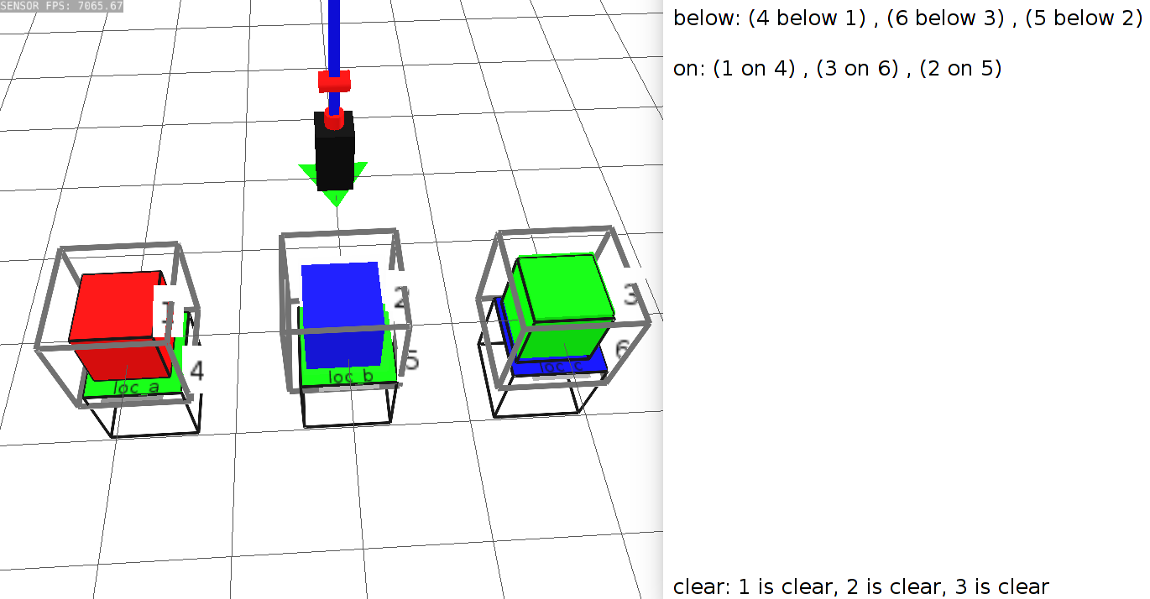
Implemented transparency mechanisms
*
Question-answering mechanisms
What do you see? What is ‘clear’?
Visualization mechanisms
*
Ramaraj et al. Towards using transparency mechanisms to build better mental models. ACS workshop on goal reasoning (2019)
Notes:
So Mary can literally ask the robot, “Can you pick up a mug” or “Do you see a mug”, And in a study I did where people had to use transparency mechanisms to understand why the robot failed, and since one way to measure a person’s mental model is by asking them to predict what happened, we can see that there was significant difference when people had access to it.
However, that’s not how people truly interact. What is more likely to happen, is Mary is likely to use a trial and error situation to see where it takes her.

Slide 13

Transparency mechanisms
I see a small block on a medium block, a medium block on a large block and a large block …….I also see a green location and a blue location.
What do you see?
Instructor
ITL robot
Notes:
So here, the instructor can ask what can the robot see, and based on its description, they are able to accurately update their mental model. We conducted studies and determined that these positively contribute to the person’s mental model.
Prior work has implemented tms to allow instructor access, but here we wanted to study it from the mental model perspective ---- We wrote a paper discussing this role.
So today my talk is going to be about how we implemented specific transparency mechanisms in order for a non-expert user to be able to identify why the robot failed. Clearly, this is the first crucial step.
How do we quantify this? By using the user’s accuracy and confidence to do the same.again, very little work has looked at just quantifying a person’s mental model when it comes to a robot. We think we ought to take a smaller step approach to this.

Slide 14
Mary’s trial instruction
Perfect instruction:
Mary: Deliver the mug to Alice in the
conference room.
A different instruction:
Mary: Deliver the coffee to Alice.
This instruction will not be executed. Why?
What is coffee?
Where is Alice?
Alice
Opportunity to update mental model
Mary
Rosie
Mug
Notes:
In an ideal situation, the robot takes this instruction and just runs with it.
However, we are working with non-experts who don’t know what the robot knows. There are many things that can go wrong here.
Does the robot know what a mug is?
How does it know where Alice is?
This is the perfect opportunity to update the person’s mental model. Because what the robot says in this scenario, will help the person understand what the robot is currenty going through.

Slide 15
Robot’s response to instruction
Mary: Deliver the coffee to Alice.
Robot: I cannot do that.
Robot: I do not know what coffee is.
What robot responses lead to accurate updates to an instructor’s mental model?
Alice
Mary
Rosie
Mug
Notes:
SO for example, there is a difference between nwhen the robot says “I cannot do that” vs when the robot says “I do not know what coffee is”. Both these responses will evoke different instructions from the person about what to do next. Towards this, I am working on a study
There has been a current study that looks at human-human interact
And the goal is that when these failures occur, using the knowledge that the robot has, and existing social science research to write rules that allow the robot to provide a relevant explanation for the person to move forward.

Slide 16
How to update instructor’s mental model?
Robot knowledge
Perception
World representation
Declarative knowledge
Procedural knowledge
Interaction with the robot
Modes of instruction (questions, commands)
Robot’s interaction capabilities (confirmation,
ask for help, learn new concepts etc)
Alice
Mary
Rosie
Mug
Notes:
For this, I look to existing theories that talk about human-human interaction

Slide 17

SharedPlans
Plan-based theory of dialogue (Grosz and Sidner, 1990)
Each participant’s utterance is intentional
Act together towards goal
Update others’ beliefs based on fact
…….
…….
Instructor
ITL robot
Notes:
One such model is SharedPlans, which is a plan-based theory of human dialogue.
It posits that each participa
What this means is that each utterance can be used to introduce information or request informations pecifically to to update each partner’s mental model either through assimilation of new knowledge or confirmationof existing knowledge
But this is a theory for human-human interactions. Does this actually apply to human robot interaction

Slide 18
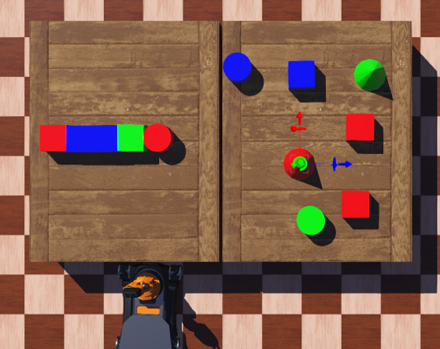
Human teaching is intentional!
Human participant study (N=10)​
Task: Teach how to build 2 walls to ResAgent (learning agent played by the interviewer)
Intentions observed
Inform
Evaluate
Expand past knowledge
Correct student knowledge
Revise Instruction
Ramaraj et al. Unpacking Human Teachers' Intentions For Natural Interactive Task Learning. To appear in RO-MAN 2021
Notes:
In a study I conducted as a part of my internship, where people were asked to teach a learning agent to build, we characterized different aspects of human teaching which can be found in this paper that will be published in the RO-MAN conference. But the relevant part for today, is that we found that human instructions are intentional!
And in our study, we were able to find these 5 intentions. These are by no means exhaustive, but they provide a great starting point to incorporate a SharedPlans-like theory.

Slide 19
Robot’s mental model of the instructor
Notes:
And in order to do this effectively, i.e. so that the robot can provide relevant information to the person, To update someone else’s beliefs, you need to have a good model of their beliefs in the first place.
It’s important that the robot has some model of the human intends to, for our purposes, from a teaching perspective. It can gain access to the person’s goals, intentions and knowledge in the teaching scenario. This can initially start of as general expectations such as don’t repeat information etc. But over time the hope is that the robot can also intentionally learn the person’s preferences, and their word usages in order to match language to make this teaching process even more effective.
The idea is to have increasing personalization based on additional interaction.
But this is asking for a lot. Actually recognizing the intent of all instructions is a really big problem. Interestingly enough, in a study

Slide 20
Current interaction model
Task knowledge
Deliver the coffee to Alice.
Identify type of instruction
Language Comprehension
Interpret
instruction
Interaction module
Instructor
Rosie
Notes:
Here is a highly simplified version of the ITL robot Rosie’s architecture I am going to be focusing on the interaction module.
This then goes to the SharedPlans-based interaction module that takes into account the environment and the task knowledge it has.
Currently, Rosie’s language understanding is stilted, so the instructor has to give very specific language instructions that can be hard for a non-expert.
The person has to ask for exact things to get exact responses.
Vs, if the person says “I want to use the evaluate intention to learn x” -> the agent can provide options for the person to choose in terms of transparency mechanisms.
Make this more structured based on CDT and SharedPlans.

Slide 21
Proposed interaction model
Evaluate(Deliver, coffee, Alice,
“demonstrate”)
Task knowledge +
Instructor model
Templates
Inform
Evaluate
Revise
Identify intention
SharedPlans-based interaction module
Language Comprehension
Instructor
Rosie
I don’t know what coffee is.
Notes:
I plan to build intention-based templates that people can use to interact with the robot – so if they would like to evaluate the robot by asking it to describe its environment
The reason for this is that I care about the information exchange, and until the robots are not capable of understanding all possible instruction, this would be a powerful way for the person to still communicate their instructions to the robot, through which intent can be extracted.
We have an existing interaction module in our robot that is based on
Let’s look at an example of what this looks.
Given this environment.
We would extract intention and the other variables in the interaction module, and use the existing transparency mechanisms to respond to this request.
Maybe include?? - The goal of my various projects with respect to understanding mental models, is to incorporate these responses. For example, if the robot runs into a failure because of an instruction, it should be able to provide the right response
Make this more structured based on CDT and SharedPlans.

Slide 22
Evaluation
Goal of implementation: Improve instructor’s mental model of the robot
Compare proposed implementation with current Rosie model
Qualitative evaluation
Cognitive load
Participant experiences and preferences
Quantitative measures
Number of turns taken
Accuracy of participant’s knowledge about robot
Task success
Task completion
Notes:
(What am I going to vary when I evaluate the system? Don’t go into too much details about user study – he wants to know what am I trying to measure?)
What have I done in the past?
What am I going to do?

Slide 23


Lots of ideas, implementation is NOT done and not trivial
Studies still only provide us access to subsets of population
Incorporating human-centred theories
Taking it one step closer to non-expert humans interacting with robots
Actual studies to collect non-expert feedback

